Slide 1

Disaster Recovery In Telecommunications Environments
Eng Roqia Al-Hamdi
System Admin Supervisor- Sabafon

Slide 2
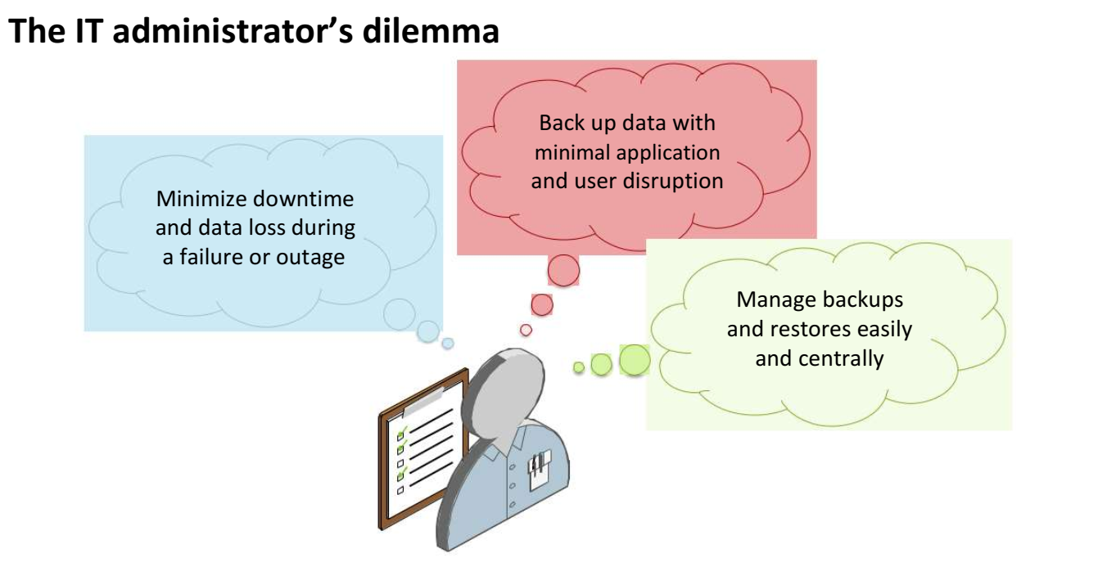

Slide 3
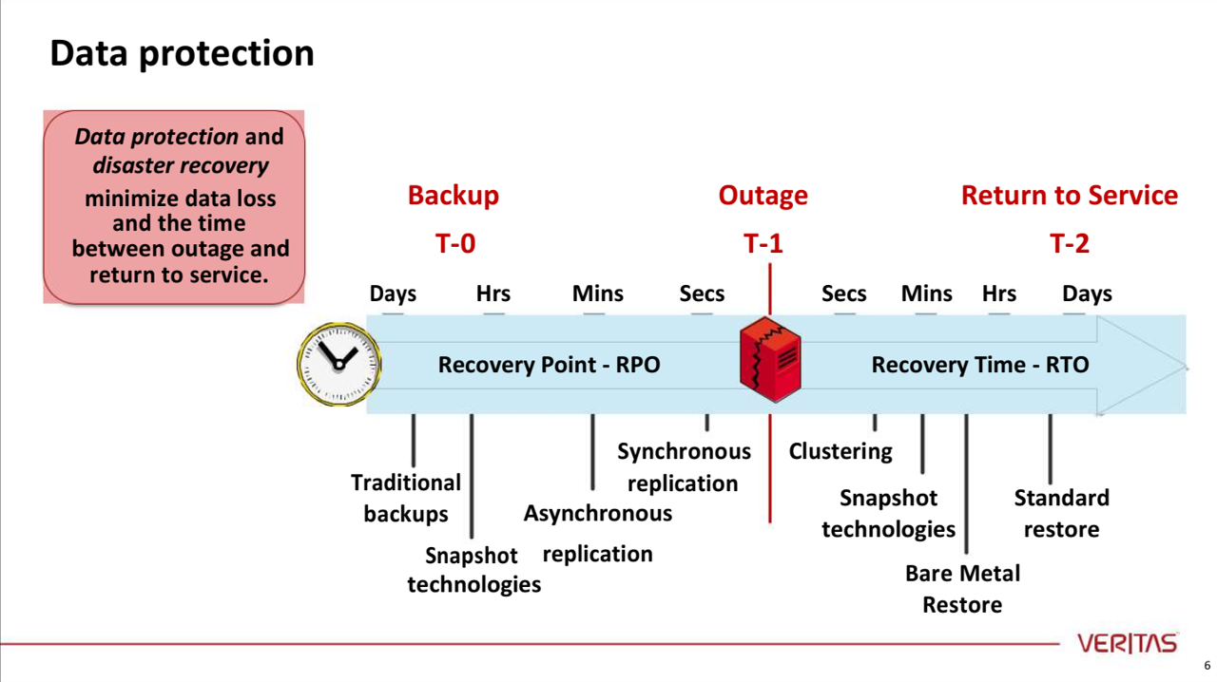
RTO\RPO

Slide 4
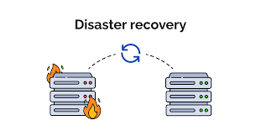
Disaster Recovery
Disaster recovery (DR) is a coordinated strategy that enables organizations to restore IT infrastructure, data, and business operations following a disruptive event. It focuses on minimizing downtime and data loss, ensuring business continuity by rapidly restoring critical systems and functionalities after a disaster.

Slide 5
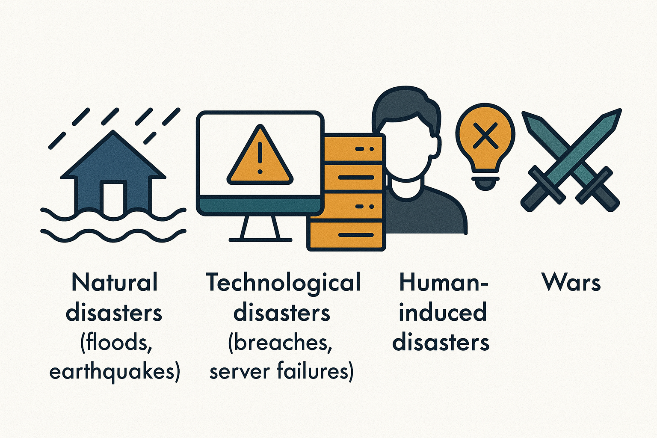
Type Of Disasters
Natural disasters (floods, earthquakes)
Technological disasters (breaches, server failures)
Human-induced disasters (human errors or intentional sabotage)
Wars

Slide 6
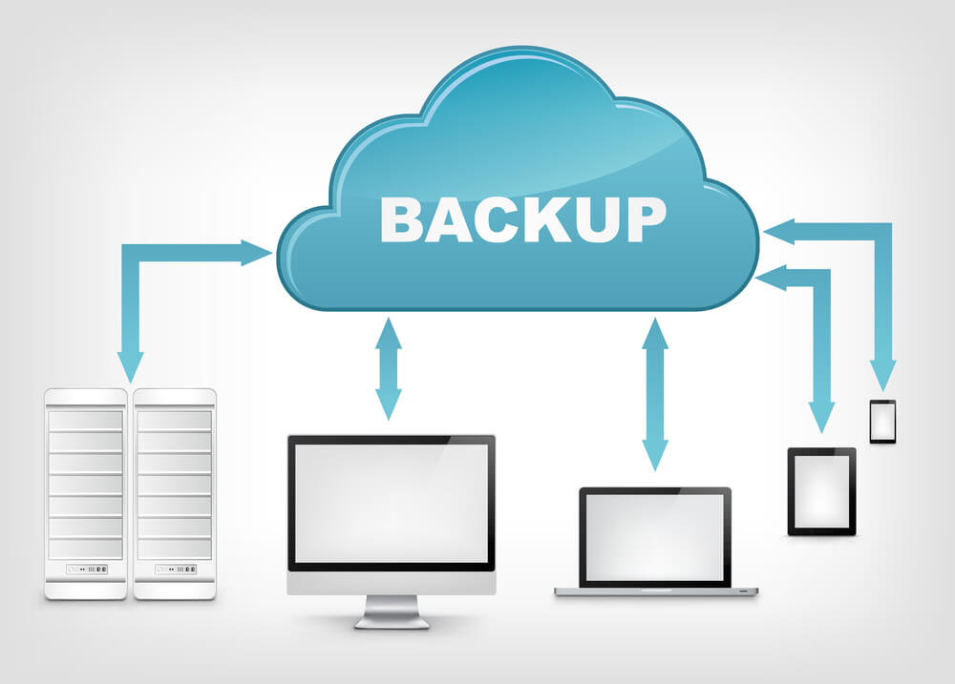
Backup
Backups and Offsite Storage
DRP should fully address backup strategy implemented by your organization
◆ First step of implementation is backing up the data!
◆ Three main types of backups:
  ○ Full Backup
  ○ Incremental Backup
  ○ Differential Backup

Slide 7
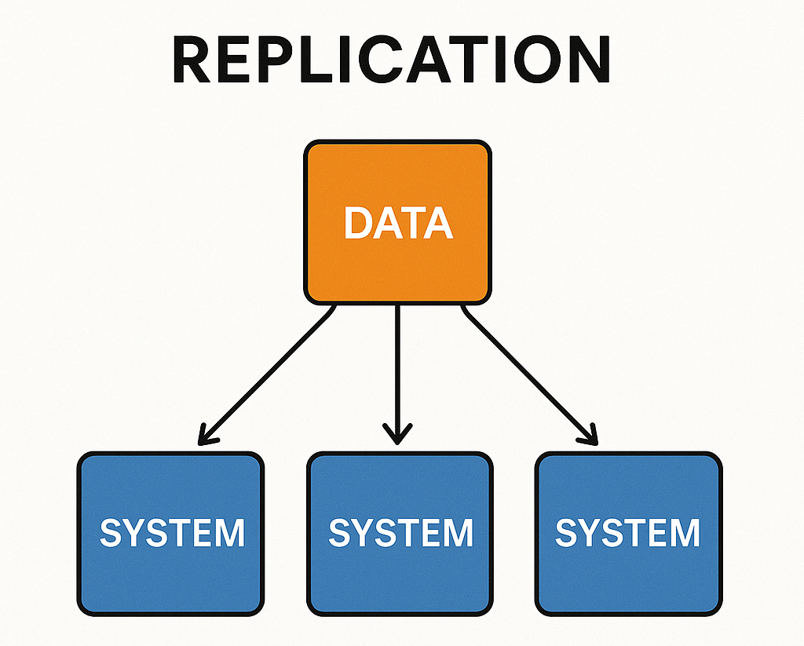
Replication
Replication generally refers to the process of copying and maintaining data or resources across multiple systems to ensure availability, consistency, fault tolerance, and performance.

Slide 8
Replication
1. Replication Types
Replication can be categorized based on how and what is replicated:
1- Data Replication
2- File/System Replication
3- Storage Block Replication
4- Virtual Machine (VM) Replication
5- Application Replication
Replication Modes
Also called replication types based on timing:
1-Synchronous
2- Asynchronous

Slide 9
Alternate Processing Sites
◆ Selection of alternate processing sites to be used when the primary sites are unavailable.
◆ Types of Sites commonly used in Disaster Recovery planning:
  ○ Cold Site
  ○ Warm Site
  ○ Hot Site
  ○ Rolling/Mobile Site
  ○ Service Bureaus
  ○ Multiple Sites
  Redundant Site

Slide 10
Disaster Recovery Plan
A disaster recovery (DR) plan outlines procedures to restore IT infrastructure and data after an outage, ensuring business continuity

Slide 11
Disaster Recovery Plan
1. Identify Critical Systems and Data:
Inventory:
Maintain a detailed inventory of all hardware, software, and network configurations.
Prioritize:
Determine which systems are essential for business operations and need to be recovered first.
Data Backup:
Implement a robust backup strategy, including offsite backups, to protect critical data.
2. Define Recovery Time and Point Objectives (RTO/RPO):
RTO: The maximum allowable downtime for a system or application after a disaster.
RPO: The maximum acceptable age of data that can be recovered after a disaster.

Slide 12
Disaster Recovery Plan
3-Develop Recovery Procedures:
Hot Site/Cold Site:
Establish procedures for using alternative sites (hot or cold) in case of site unavailability.
Mobile Site:
Plan for situations where operations need to shift to a temporary location with backup systems.
Data Restoration:
Define the steps for restoring data from backups, including timelines and required resources.
System Rebuilding:
Outline the process for rebuilding data centers or critical infrastructure if needed.

Slide 13
Disaster Recovery Plan
4- Communication and Documentation:
Emergency Contact List:
Maintain an up-to-date list of key personnel and their contact information.
Communication Channels:
Establish clear communication channels for disseminating information during a disaster.
Documentation:
Document all procedures, contact information, and recovery steps in a readily accessible format.
Regular Updates:
Regularly review and update the DR plan to reflect changes in systems, applications, and procedures.

Slide 14
Disaster Recovery Plan
5- Testing and Training:
Regular Testing: Conduct regular tests of the DR plan to ensure its effectiveness and identify areas for improvement.
Employee Training: Train employees on their roles and responsibilities in the DR plan.

