Slide 1

د/ عدنـــــــان حيــــــدر
رئيس قسم الامن السيبراني والشبكات
جامعـــــــــــــة الـــــــــــــرازي

Slide 2

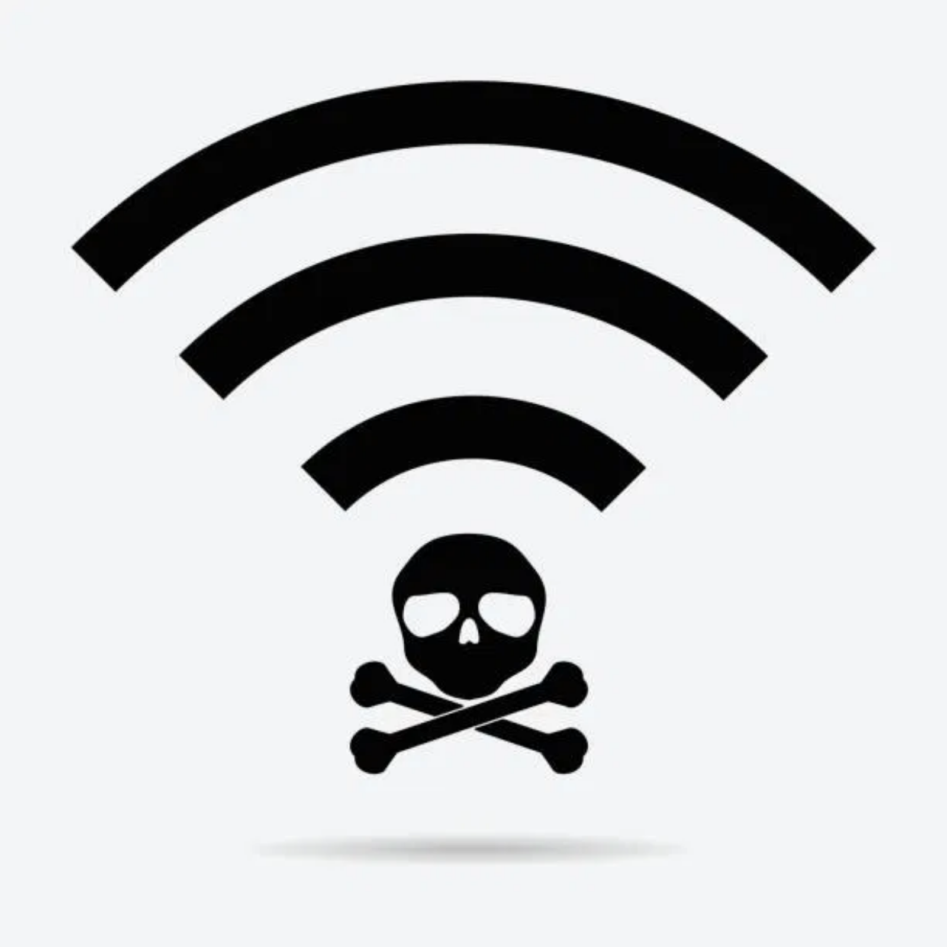
WiFi Security: Protecting Your Digital Life
Understanding Risks and Solutions for Everyday Users
In today's connected world, WiFi networks are everywhere - but so are the risks.
This presentation will help you understand:
Common WiFi security threats
Real-life scenarios where you're vulnerable
Practical solutions to protect yourself
Emerging trends in wireless security
No technical background required!

Slide 3
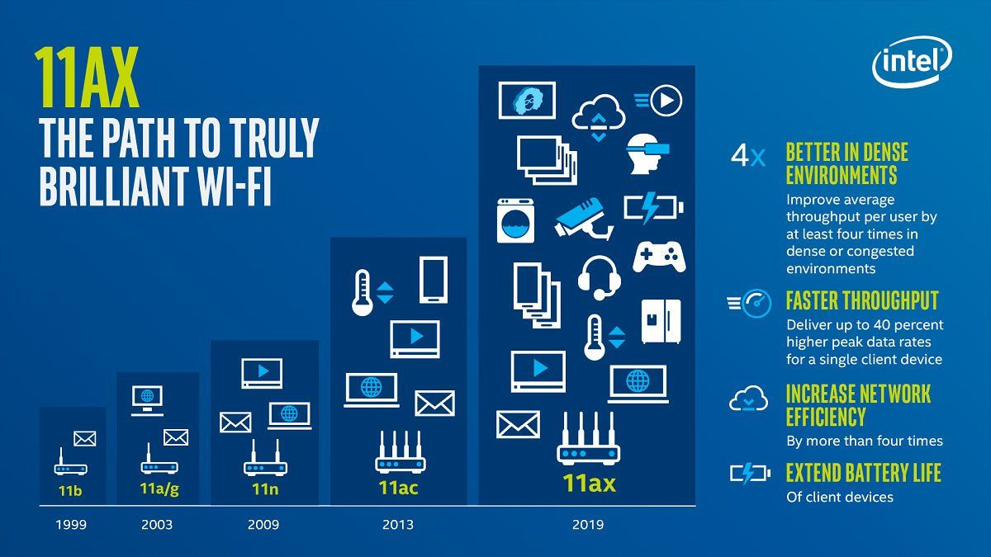

Slide 4


Slide 5

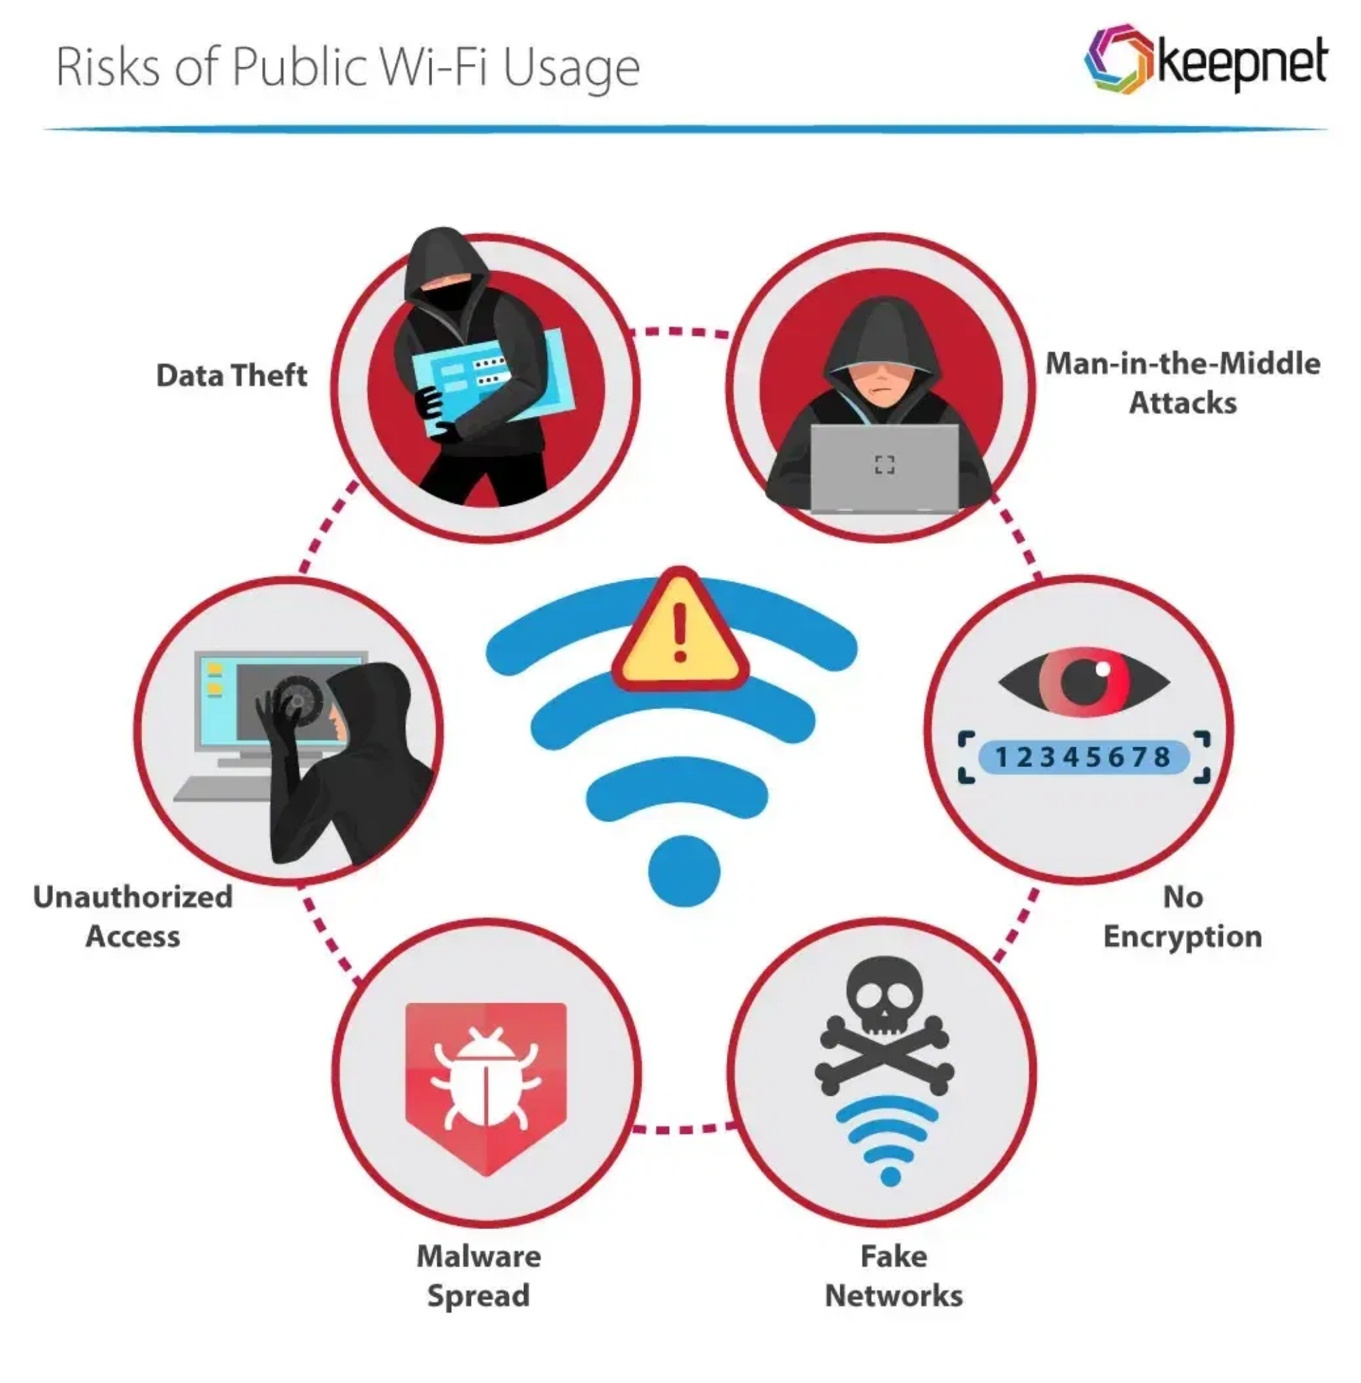





Common WiFi Security Threats
Man-in-the-Middle Attacks
Attackers intercept communications between your device and the network
Weak Passwords
Easy-to-guess passwords make networks vulnerable to brute force attacks
Rogue Access Points
Fake hotspots designed to steal your data when you connect
Outdated Router Firmware
Unpatched vulnerabilities that hackers can exploit
Unsecured IoT Devices
Smart devices with poor security become entry points for attackers

Slide 6
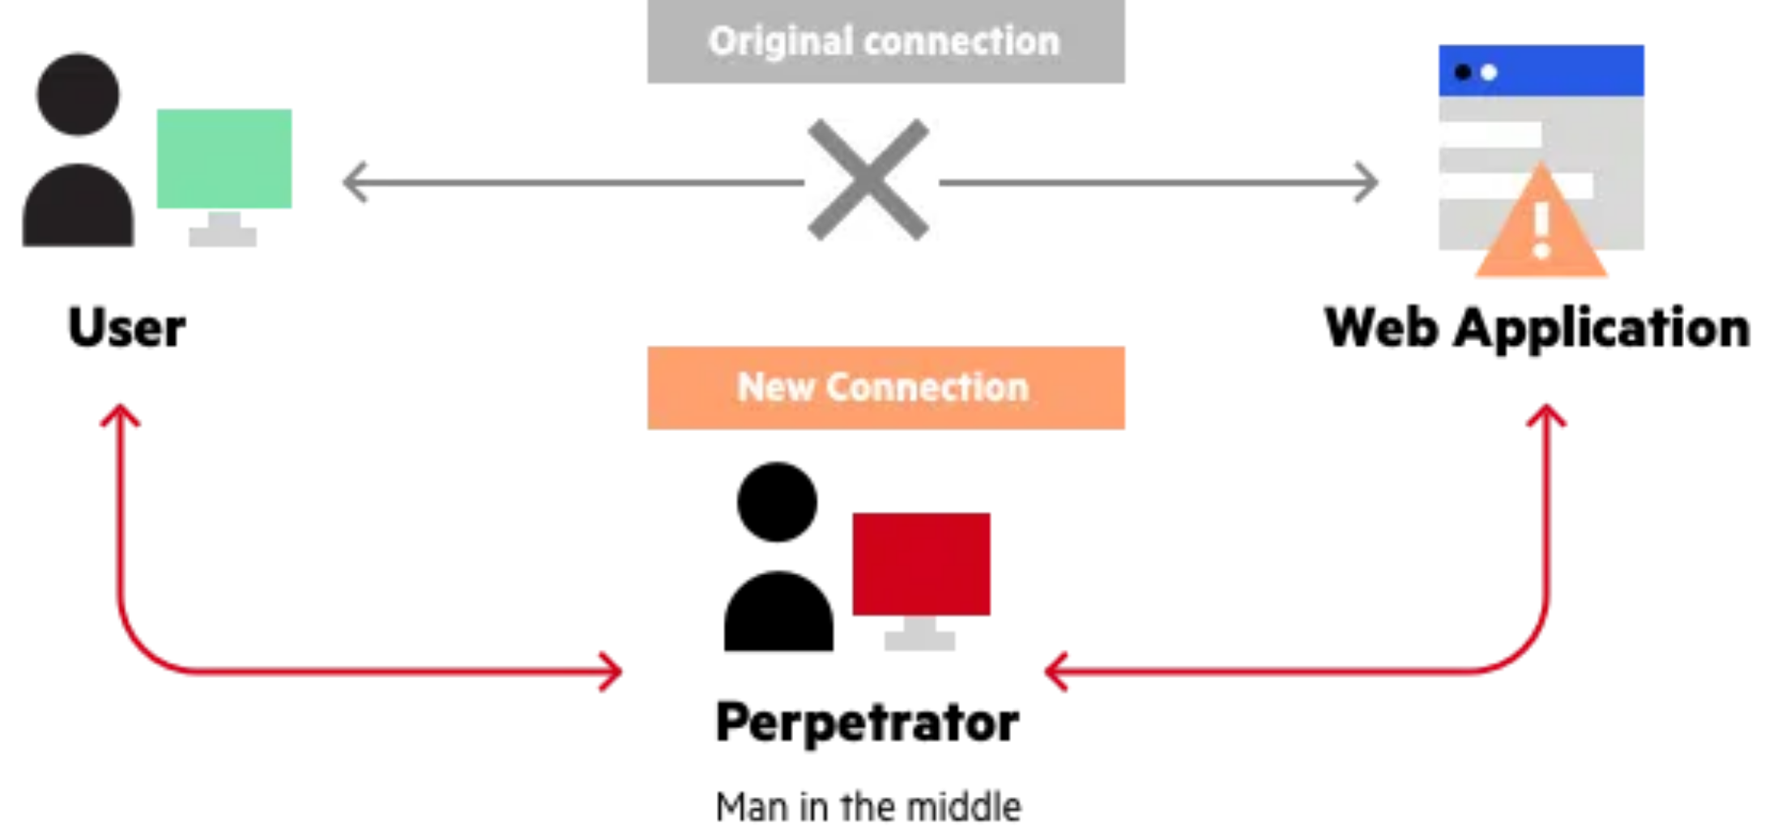

Man-in-the-Middle Attacks Explained
1
The Setup
Attacker positions themselves between your device and the WiFi network, often using specialized tools or rogue access points.
2
The Interception
All your internet traffic passes through the attacker's device before reaching its intended destination.
3
The Theft
Attackers can view unencrypted data, including passwords, credit card details, and personal information.
Why It's Dangerous
These attacks are nearly invisible to users and can happen on any unsecured network, especially public WiFi at cafes, airports, and hotels.

Slide 7

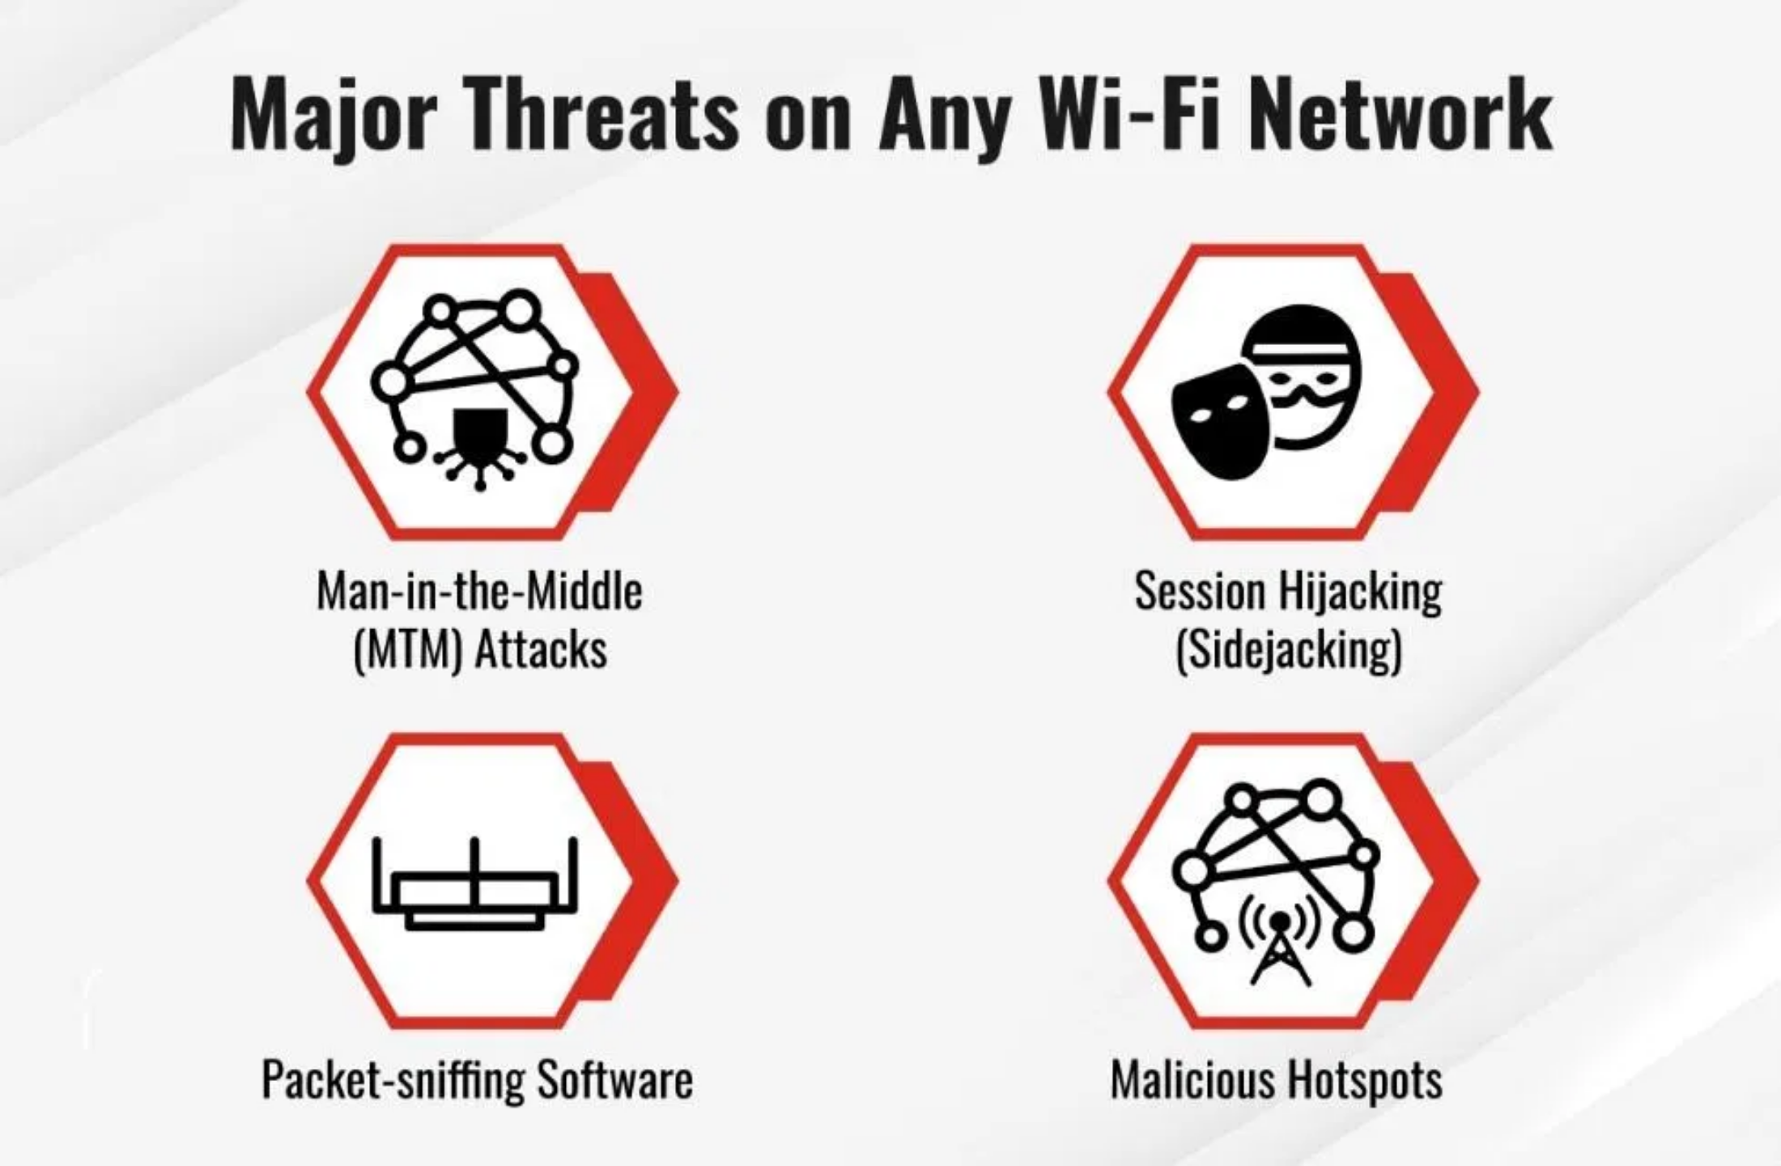



Real-life Scenarios: When You're at Risk
Coffee Shops
High Risk
Popular targets for attackers due to high traffic and users often accessing sensitive accounts while connected.
Airports
High Risk
International travelers are prime targets as they often need to access banking and travel information.
Hotels
Medium Risk
Hotel networks often have minimal security and are shared among many guests, creating opportunities for attackers.
Shopping Centers
Medium Risk
The most vulnerable moments are when you're checking email, accessing bank accounts, or entering passwords on public WiFi.
Free mall WiFi networks are rarely secured properly and often used for online shopping with credit cards.

Slide 8
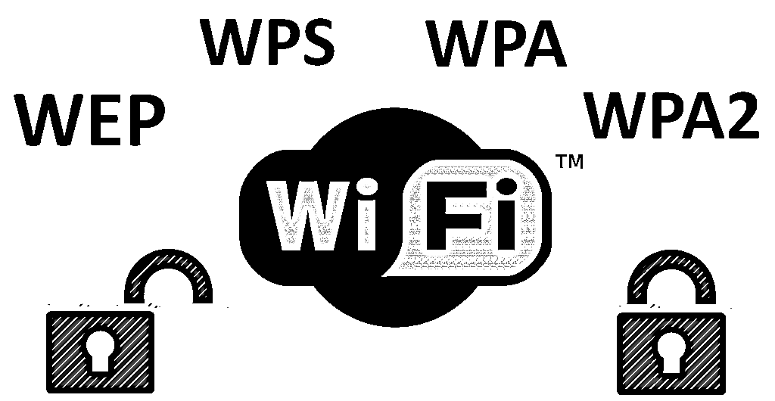




Slide 9
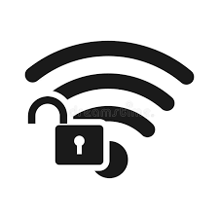

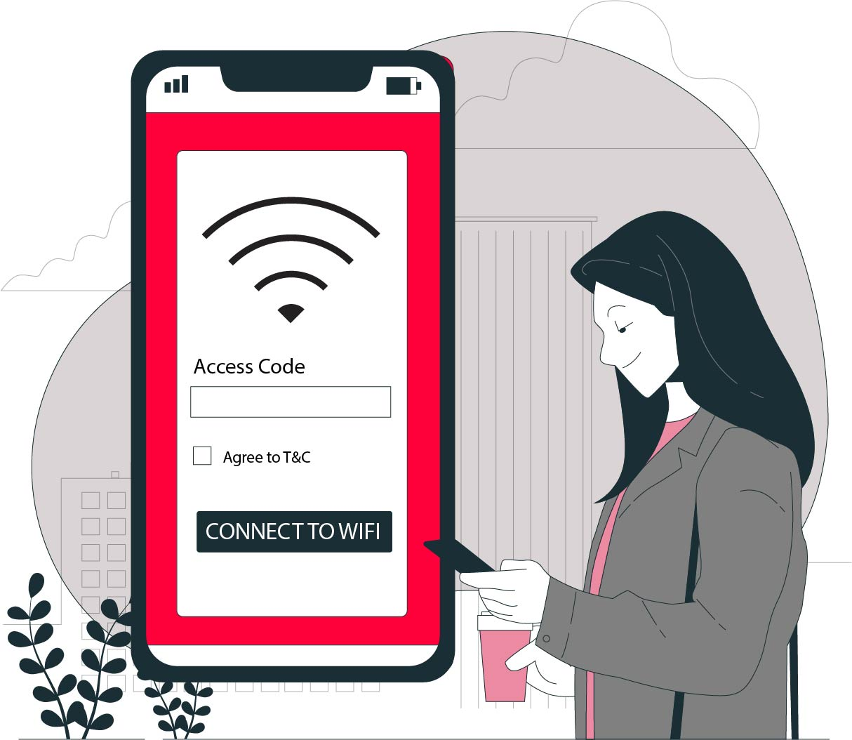
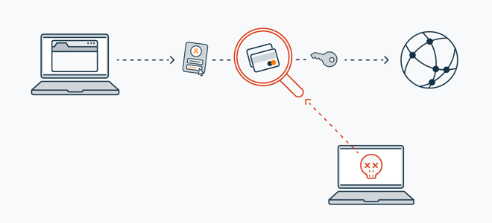
Public WiFi
No WiFi Password
WiFi Password is
12345678

Slide 10

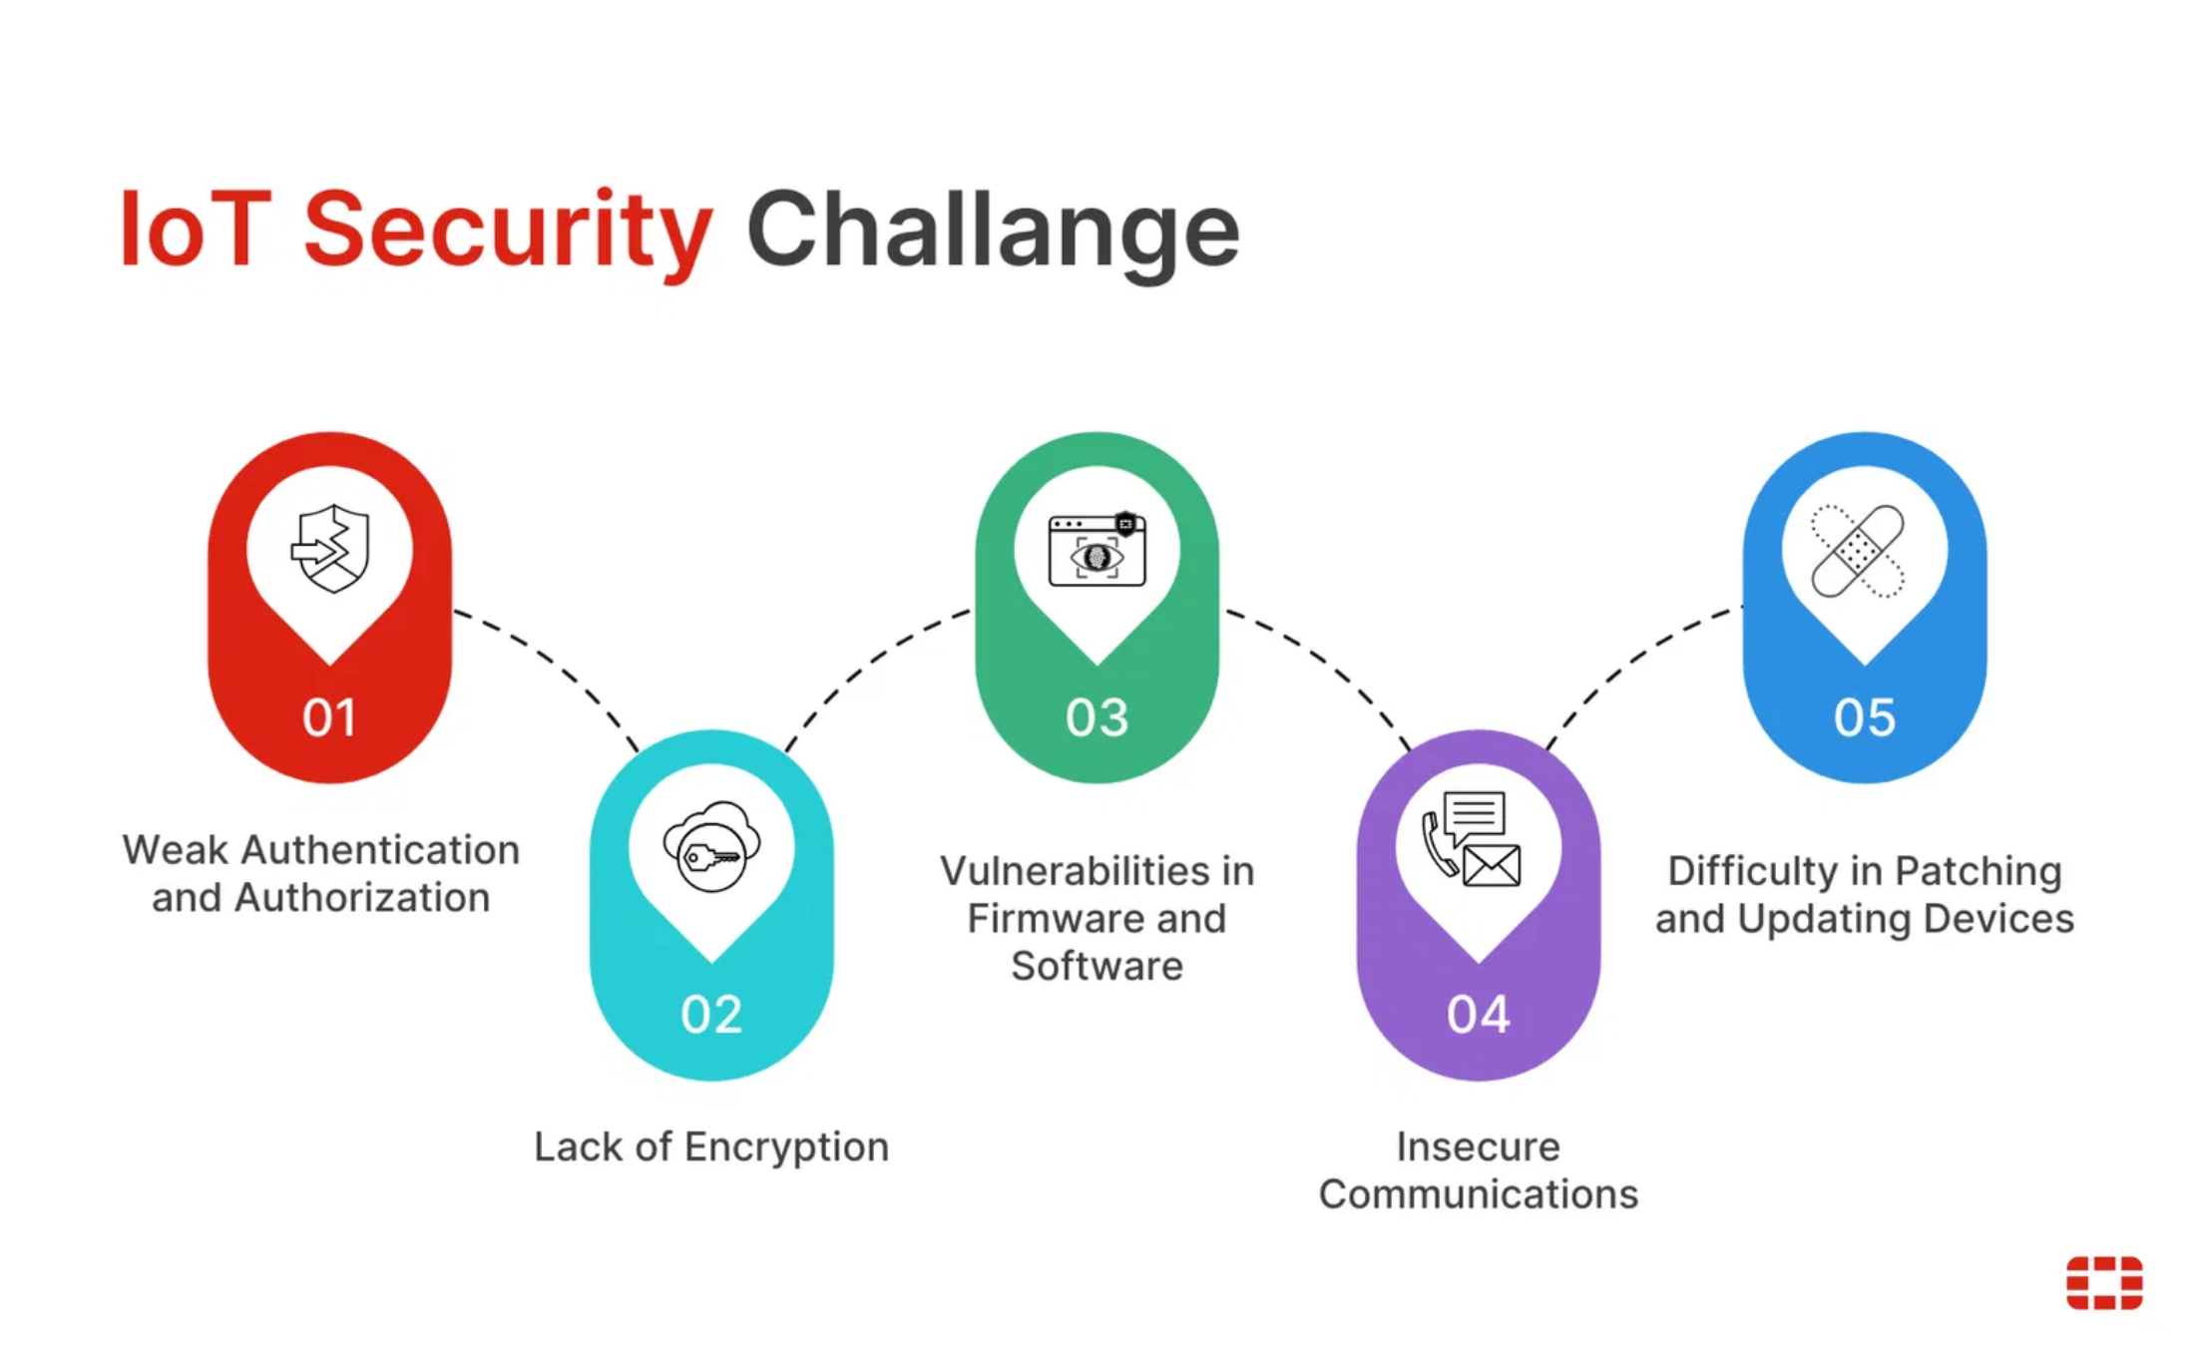




The Growing IoT Security Challenge
Why IoT Devices Are Vulnerable
Default Credentials
Many IoT devices ship with default passwords that users never change, creating easy access for attackers.
Infrequent Updates
Manufacturers often provide limited or no security updates, leaving devices vulnerable to known exploits.
Limited Security Features
Many IoT devices lack basic security features like encryption or secure boot processes.
Network Access
Once compromised, IoT devices can provide attackers with access to your entire home network.
The Scale of the Problem
By 2025, it's estimated that over 75 billion IoT devices will be connected worldwide, creating an enormous attack surface for hackers.

Slide 11

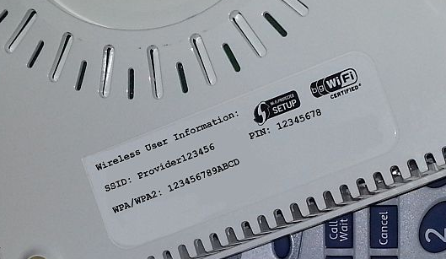

Slide 12

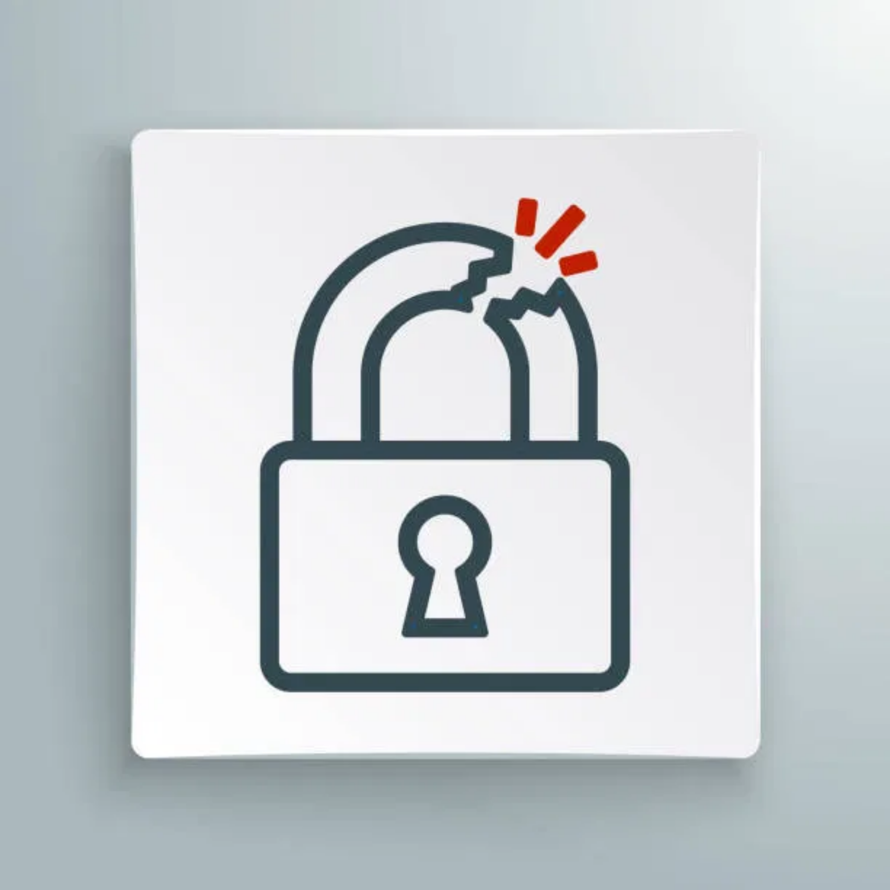






WPS: Convenience vs. Security
What is WPS?
**Wi-Fi Protected Setup (WPS)** is a feature designed to make connecting devices to a wireless network easier, often using a simple PIN or button press.
The Weakness
Despite its convenience, WPS has a critical design flaw: its 8-digit PIN can be brute-forced in a matter of hours due to a mathematical vulnerability.
Once the PIN is cracked, an attacker gains access to your WiFi password and, consequently, your entire network.
Recommendations
**Disable WPS:** The most effective way to protect yourself is to disable WPS on your router. Check your router's administration panel.
**Update Firmware:** Ensure your router's firmware is always up-to-date, as some updates may address WPS-related vulnerabilities.
A Broken Promise of Convenience
While WPS aimed to simplify network connections, its inherent security flaw makes it a significant risk that should be avoided.

Slide 13





Modern Hacking Tools & Techniques
WiFi Pineapple
A portable device that can create fake access points, intercept traffic, and perform man-in-the-middle attacks automatically.
Commercially Available
$99-$200
Flipper Zero
A portable multi-tool for hackers that can clone RFID cards, analyze wireless protocols, and perform various wireless attacks.
Consumer Device
~$169
HackRF One
The Democratization of Hacking
What once required advanced technical skills now comes in user-friendly packages with simple interfaces and automated attacks.
A software-defined radio that can intercept, analyze, and transmit radio signals across a wide frequency range.
Advanced Tool
~$300
These tools are becoming increasingly accessible to non-technical users, lowering the barrier to entry for potential attackers.

Slide 14







Basic Security Solutions
Strong, Unique Passwords
Use complex passwords with at least 12 characters including numbers, symbols, and mixed case letters. Never reuse passwords across networks.
WPA3 Encryption
Upgrade your router to use WPA3, which provides stronger encryption and protection against brute force attacks than older protocols.
WPA3: The New Standard
WPA3 introduces individualized data encryption, stronger protection against brute-force attacks, and simplified secure device setup.
Regular Firmware Updates
Keep your router and connected devices updated with the latest firmware to patch security vulnerabilities.
Compatibility:
Most devices manufactured after 2019 support WPA3, but it's
backward compatible with WPA2 for older devices.
Hide Network SSID
Configure your router to not broadcast its network name, making it less visible to potential attackers.
Pro Tip
Consider using a password manager to generate and store complex, unique passwords for all your networks and online accounts.

Slide 15
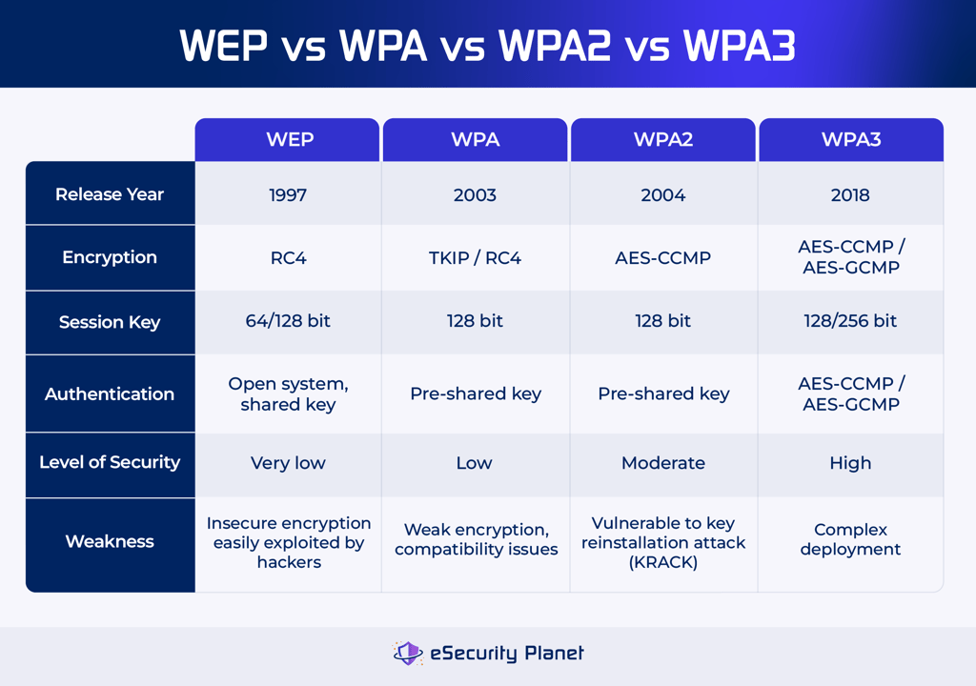
Offline dictionary attack
Online attack

Slide 16
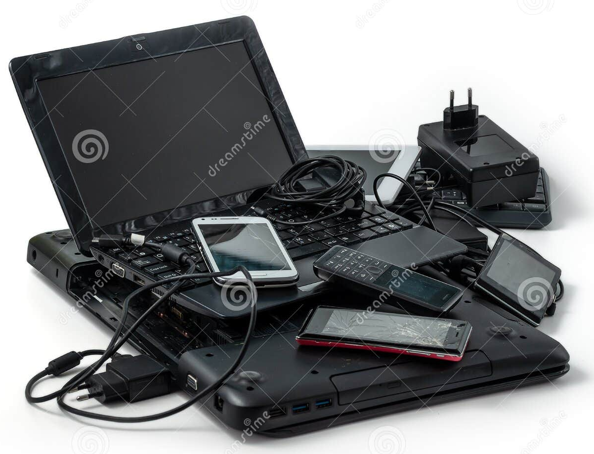
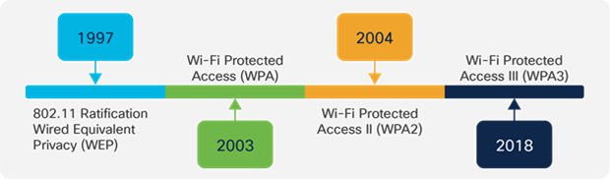
Why Don’t IT Apply WPA3
Old devices doesn’t support WPA3

Slide 17





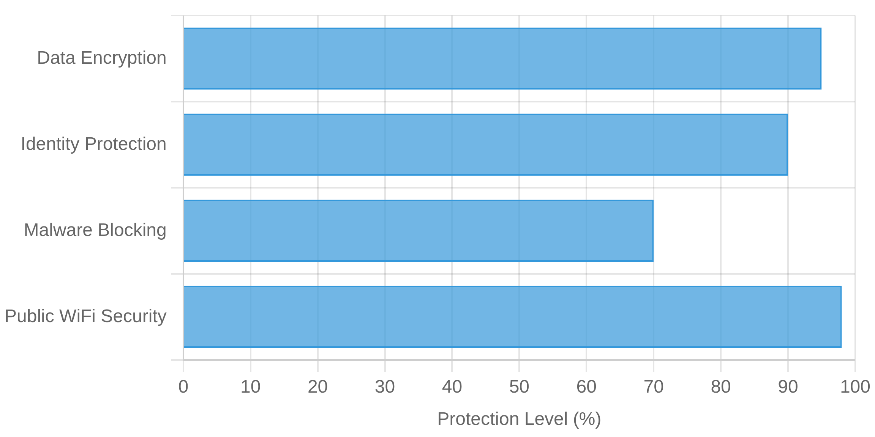

Advanced Protection Methods
Virtual Private Networks (VPNs)
Creates an encrypted tunnel for your internet traffic, protecting your data even on unsecured networks.
Encrypts all internet traffic
Masks your IP address and location
Prevents ISP and network monitoring
Guest Networks
Create a separate network for visitors and IoT devices, isolating them from your main network and sensitive data.
How a VPN Protects You
Network Monitoring Tools
Use software to monitor your network for unauthorized devices and suspicious activity.

Slide 18

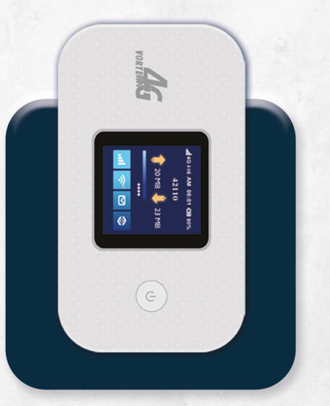
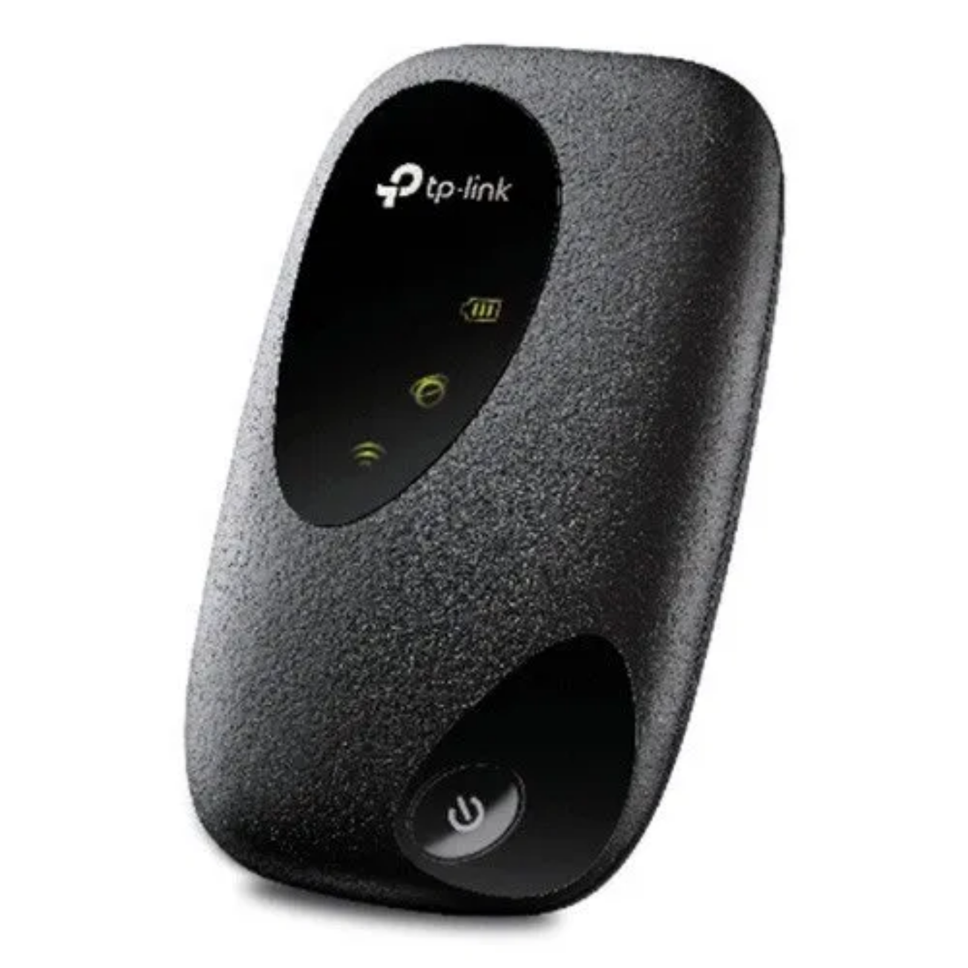




4G Pocket Routers: A Secure Alternative
Why Choose a Pocket Router?
Private Connection
فورتكس 3V
Creates your own secure WiFi network using cellular data instead of sharing infrastructure with strangers.
Cellular Encryption
Uses cellular network encryption which is typically more secure than public WiFi hotspots.
Travel Friendly
Works internationally with local SIM cards, providing secure connectivity wherever you go.
Multiple Devices
Connect several devices simultaneously while maintaining security for all connections.
فورتكس 3
How It Works
A pocket router creates a secure WiFi hotspot by connecting to cellular networks (4G/LTE), bypassing potentially compromised public WiFi infrastructure.
Battery Life:
Up to 24 hours of continuous use

Slide 19
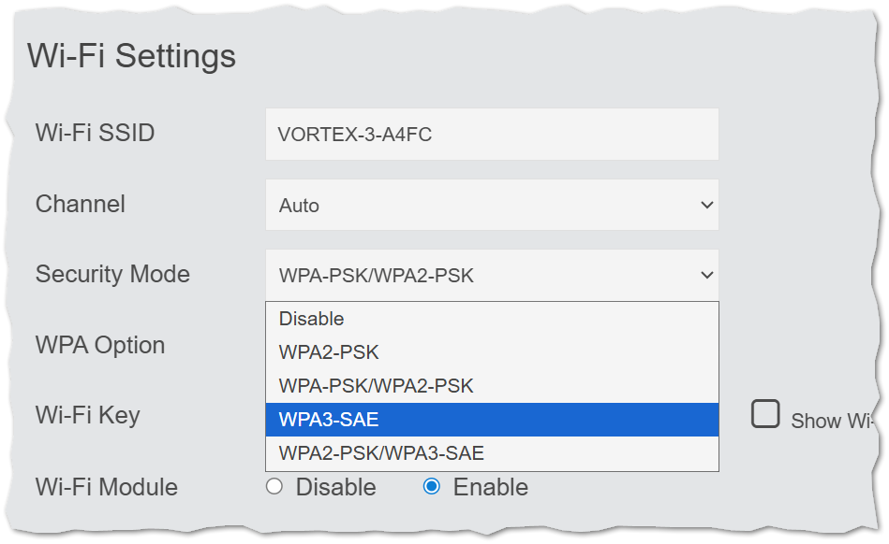
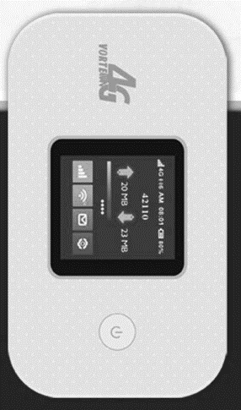

Slide 20

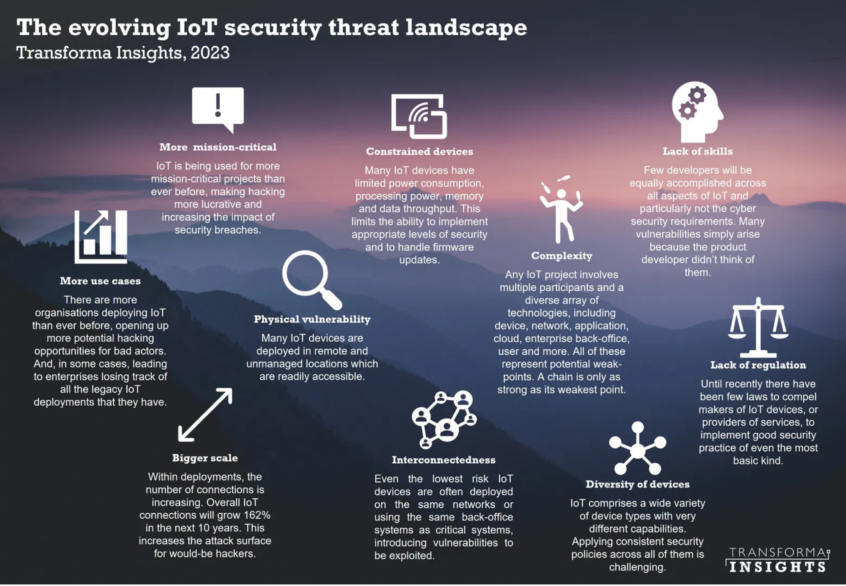



Conclusion: Staying Safe in a Connected World
Key Takeaways
1
Public WiFi networks present significant security risks, especially in high-traffic areas like cafes and airports.
2
Man-in-the-Middle attacks and rogue access points are common threats that can compromise your sensitive data.
3
Basic security measures like strong passwords and WPA3 encryption provide essential protection.
4
Advanced solutions like VPNs and 4G pocket routers offer additional layers of security when you need to connect on the go.
5
IoT devices require special attention as they often have weaker security and can compromise your entire network.
The Evolving Threat Landscape
Further Resources
As our world becomes increasingly connected, WiFi security will continue to be a critical concern. Stay informed about emerging threats and regularly update your security practices.
CISA.gov - Securing Wireless Networks
FTC Consumer Information - Public WiFi Networks
Questions?
WiFi Alliance - WPA3 Security Standard

Slide 21
Thank You

